Slide 1
Neural Networks Q&A Chatbot
Sohail Hiraj

Slide 2
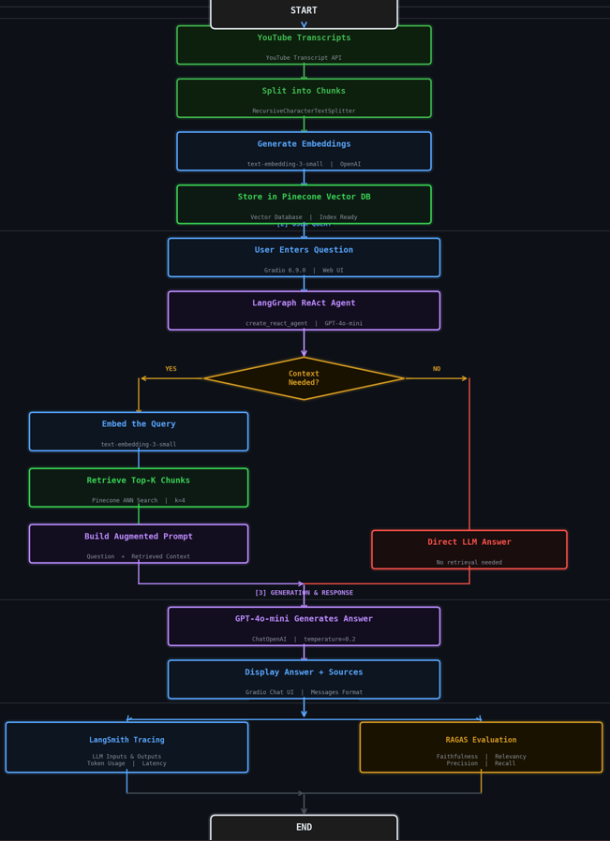
Technical Summary
AI stack
Pinecone Vector Store
LangGraph Agent
OpenAI LLM Model = gpt-4o-mini
Ragas for evaluation
Langsmith Tracing
Gradio for Deployment

Slide 3
Dataset preprocessing
youtube videos relevant to neural network
yt_dlp Library and WebVTT-py python module
Cleaning the subtitles, Removing noise, extras or duplicate sentences
RecursiveCharacterTextSplitter

Slide 4
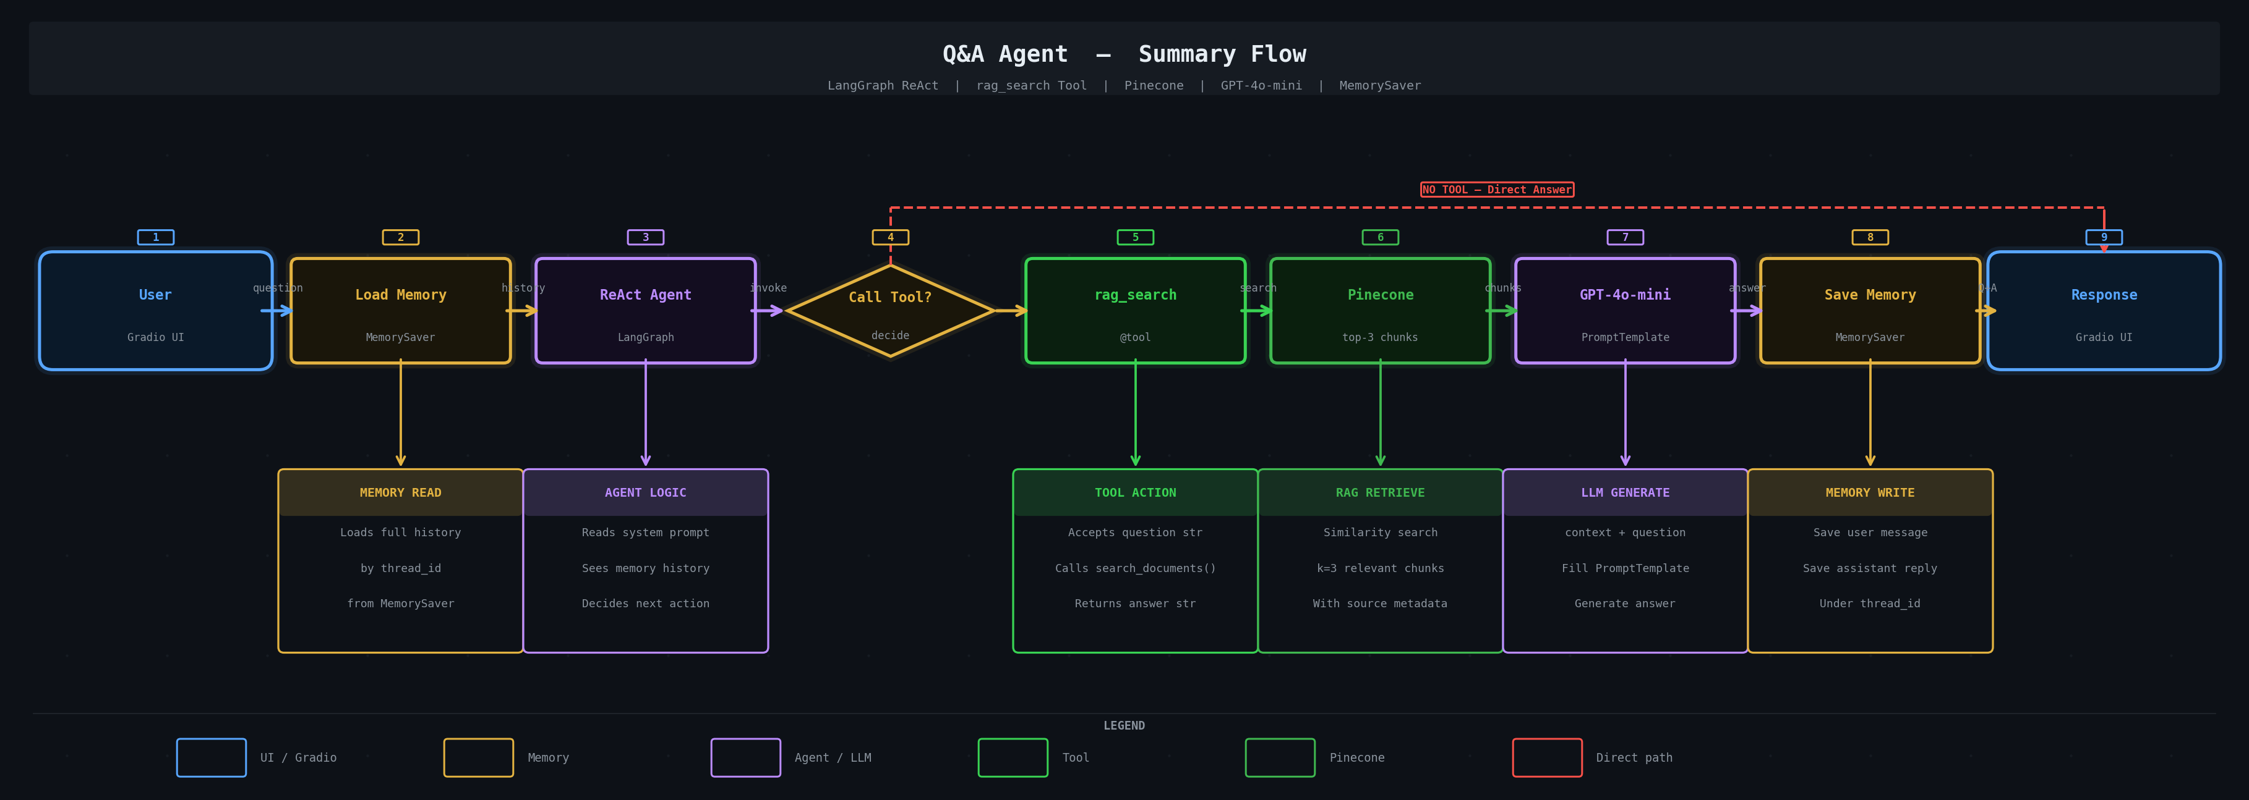
Q&A Agent
General architecture

Slide 5
Q&A Agent
Memory
MemorySaver
MemorySaver is a built-in LangGraph class that stores your entire conversation history inside your computer's RAM (memory) so the agent can remember previous messages
PromptTemplate
You are a helpful AI assistant that answers questions about neural networks "
using the rag_search tool. Always use the tool to find answers. "
Remember the conversation history and refer to previous answers when relevant.

Slide 6
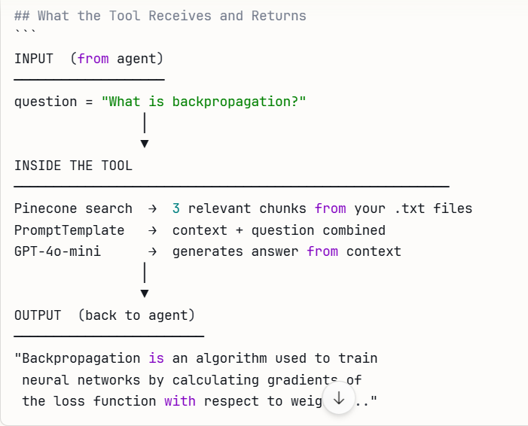
Tools

Slide 7
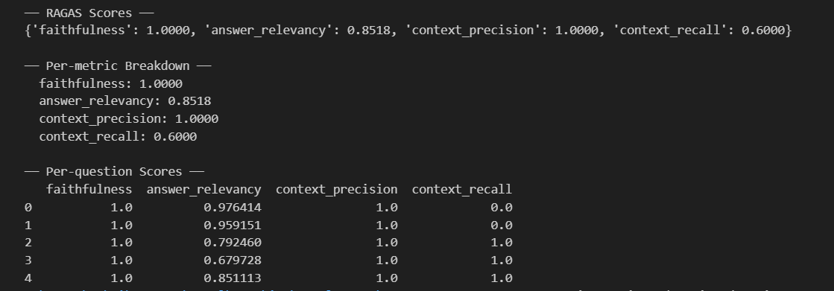
Evaluation
Ragas Metrics

Slide 8
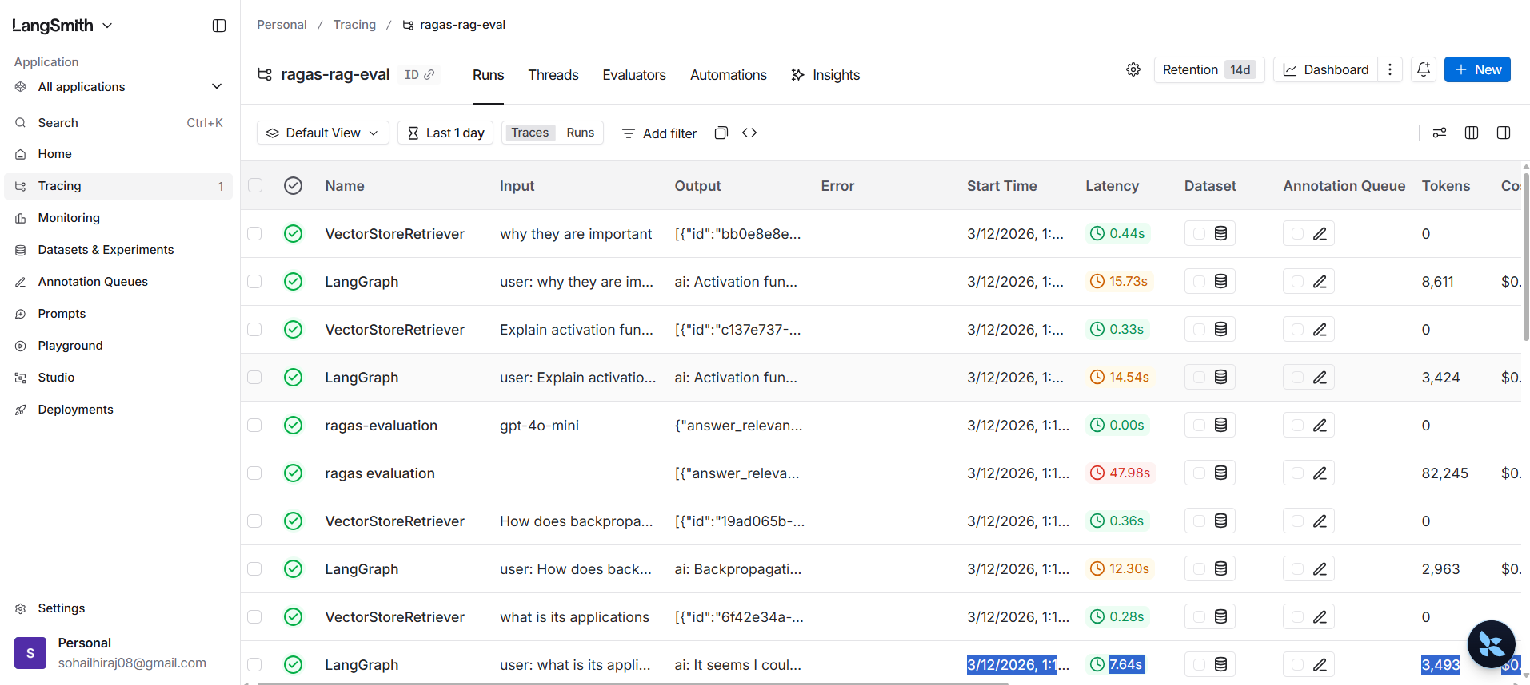
Langsmith Tracing

Slide 9
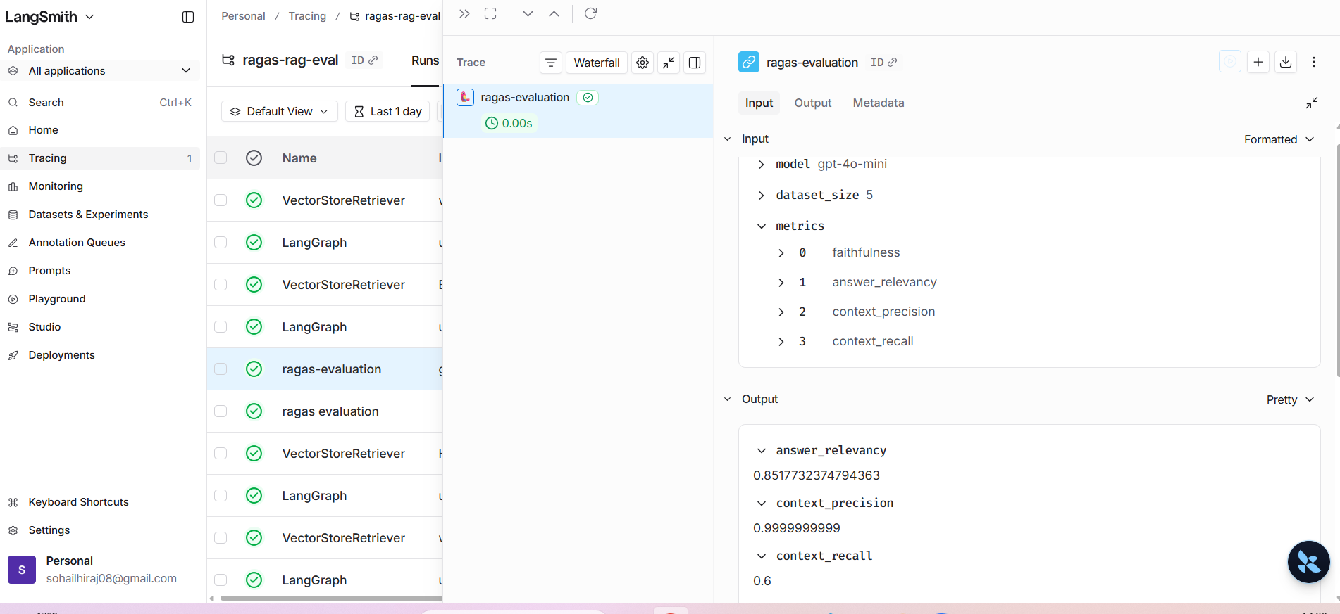
Langsmith Tracing

Slide 10
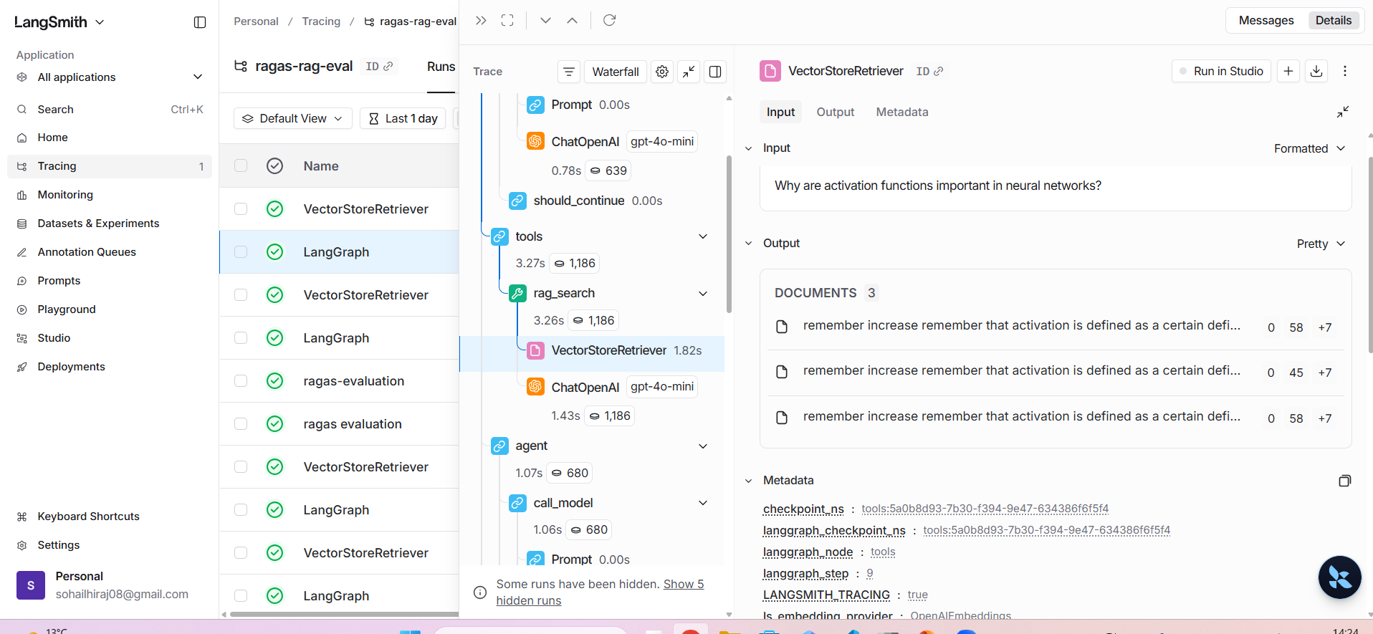
Langsmith Tracing

